Slide 1





How Sememic Components Can Benefit Link Prediction
for Lexico-Semantic Knowledge Graphs?
Hansi Wang, Yue Wang, Qiliang Liang, Yang Liu*
Key Laboratory of Computational Linguistics, Peking University
wanghansi2019@pku.edu.cn
COOLPKU/SememeLP

Slide 2

Motivation
Lexico-semantic KGs
  Vertices: synsets
  Edges: lexico-semantic relations
Task of Link Prediction (LP)
    Triples: (head, relation, tail)
  Predict missing triples in a Knowledge Graph (KG)
  Query: (h, r, ?) or (?, r, t)
automotive vehicle
synset
hypernym
car, auto, automobile, motorcar
accelerator, gas pedal, gas
meronym
hyponym
hyponym
cab, taxi, taxicab, hack
ambulance

Slide 3


Motivation
Existing LP methods
  Aim for applicability across different types of KGs
  Leverage common information in KGs:
    Structural feature
    Textual description
Limitations for lexico-semantic KGs
  Treat word senses as atomic units
  Overlook the effectiveness of internal semantic composition
    Componential analysis: word senses → sememic components
    Sememes: the minimal indivisible sememic components

Slide 4



Motivation
  Word senses within lexico-semantic relations usually show systematic differences in their sememic components.
    Antonymy: single-component negation while preserving others
    Hypernymy: subset containment
girl
human
human
boy
female
male
immature
immature
child
human
human
boy
male
immature
immature

Slide 5
Motivation
Practical Challenges of Leveraging Sememe Information
  Lacking deployment in most KGs
  Insufficient word sense coverage in existing sememe knowledge bases like HowNet
  Sememe Prediction (SP) helps address issues but faces limitations:
    Training data scarcity
      HowNet: lacks textual definitions
      SememeBabel: scarce Chinese (word sense definition, sememes) pairs
    Suboptimal SP performance

Slide 6
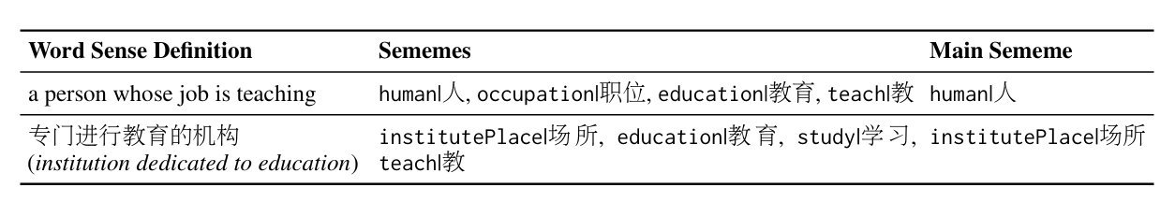
Resources
SememeDef (SP Dataset)
  Purpose: obtaining more (definition, sememes) pairs
  Construction Pipeline:
    LLMs-based semantic consistency scoring for sense pairs between HowNet and the Contemporary Chinese Dictionary (CCD)
    Select one-to-one semantically consistent pairs
    Human validation
  Scale:
    70,645 English samples (from SememeBabel)
    43,163 Chinese samples

Slide 7
Resources
HW5 & CWN7 (Chinese Lexico-Semantic LP Datasets)
  Purpose: Construct standardized LP datasets like WN18RR in English
  Construction Pipeline:
    HN7 (based on HowNet)
      Construct synsets and extract relations following OpenHowNet guidelines;
      Generate unified synset definitions via GPT-4o
      Human validation
    CWN5 (based on Chinese WordNet)
      Directly use synsets and relations from Chinese WordNet
      Convert traditional Chinese to simplified Chinese
  Scale:
    HN7: 10,939 synsets and 25,672 triples across 7 relation types.
    CWN5: 3,149 synsets and 5,395 triples across 5 relation types.

Slide 8
Methodology
Sememe knowledge representation learning
  BERT-based Sememe Knowledge Encoder
  Training Tasks:
    All-Sememe Prediction (ASP, multi-label)
    Main-Sememe Prediction (MSP, multi-class)
  Input Template:
    [CLS] [A_1]-[A_L] [ASP] [M_1]-[M_L] [MSP] word sense definition [SEP]
      [A_1] - [A_L] & [M_1] - [M_L]：learnable prompt tokens
      [ASP] / [MSP]：task-specific classification tokens
  Acquisition of sememe knowledge representation：
    All-sememe / main-sememe representation: last hidden states of [ASP] / [MSP]

Slide 9
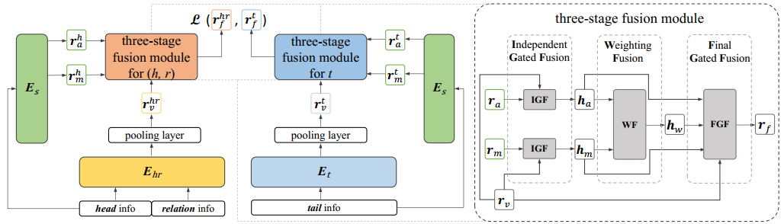
Methodology
SememeLP: enhance LP by leveraging sememe knowledge
  Three-Stage Gated Fusion Module
    Mitigate noise from potential SP inaccuracies
    Adapt to dynamic contribution differences across relation types/contexts
    Achieve complementary fusion of sememe features and structural/textual features

Slide 10
Methodology
Training details
  Train the sememe knowledge encoder on the SememeDef Dataset
  Train SememeLP on LP datasets
    Parameters of the sememe knowledge encoder are frozen
    Negative Sampling Strategy：
      Adopted from two top-performing LP methods: SimKGC & MoCoKGC
      Variants: SememeLPSim & SememeLPMoCo
    Loss Function: InfoNCE loss with additive margin

Slide 11
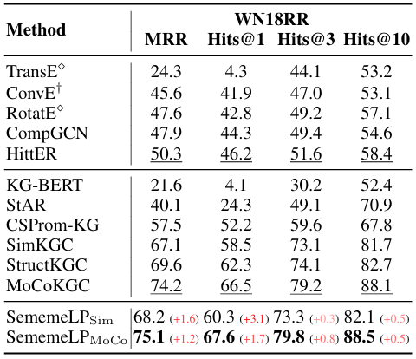
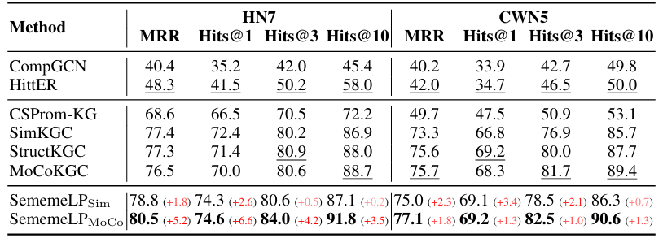
Experiments
Consistent & Significant Improvements
Larger Gains in Precise Prediction
Superior Performance on HN7

Slide 12
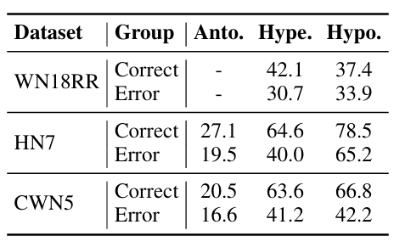
Analysis
Why does the incorporation of sememe knowledge enhance LP?
  Analysis Setup
    Grouping:
      Correct (accurate top-1 predictions)
      Error (inaccurate top-1 predictions)
    Verified Patterns:
      Antonymy: antonymous sememe pair + other sememes are identical
      Hypernymy/Hyponymy: hypernym sememes ⊂ hyponym sememes

Slide 13
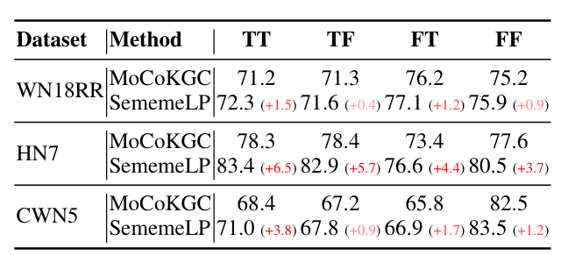
Analysis
How robust are the sememe knowledge representations?
  Analysis Setup
    Grouping Criterion: Jaccard Similarity between head/tail definitions and definitions in SememeDef
    Four Groups:
      T: High similarity (Jaccard > 0.5)
      F: Low similarity (Jaccard ≤ 0.5)
      First T/F: head similarity
      Second T/F: tail similarity

Slide 14
Summary
Contributions
  Datasets for SP and LP
  SOTA method
  Make clear how sememic components can benefit LP
  Leverage sememe information in annotation-scarce scenarios
Future Work
  More effective approaches to leveraging sememe information
  Investigate the benefits of sememe for more lexico-semantic tasks

Slide 15
The End
Thanks For Your Listening!
Hansi Wang
wanghansi2019@pku.edu.cn
COOLPKU/SememeLP

